Slide 1
《英语国家社会与文化入门》(下册）
The Society and Culture
of Major English-Speaking Countries
An Introduction
(Book Two)

Slide 2
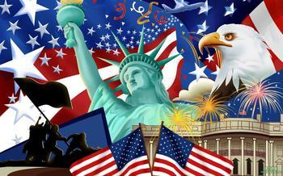
The United States of America
Unit 13 Technology in America

Slide 3
Quiz
Give the English and a brief explanation for the following:
1 爱迪生
2 亨利·福特
3 比尔·盖茨
4 乔布斯
5 再生能源

Slide 4
Focal Points
John H. Hall
the Stevens and transportation
Samuel F. B. Morse
Alexander Graham Bell
Thomas Alva Edison
Frederick Winslow Taylor
Henry Ford
the growth of radio
television
computer science
the Internet
US Space Race with the USSR
nuclear energy
renewable energy technologies

Slide 5
This Unit Is Divided into Three Sections
The Nineteenth Century
The Early and Mid-Twentieth Century
The Late Twentieth Century and Today

Slide 6
I. The Nineteenth Century
Eli Whitney: inventor the cotton gin and mass production of weapons with interchangeable parts;
John H. Hall: developing the so-called American system of production;
The Stevens family: their role in the history of transportation in early nineteenth century America;
Samuel F. B. Morse: co-developer of the Morse code, and helped to develop the commercial use of telegraphy;
Alexander Graham Bell: credited with inventing the first practical telephone;
Thomas Alva Edison: the most famous of all American inventors who is credited with the invention of the motion pictures, the phonograph, and, as everyone knows, the electric light;

Slide 7
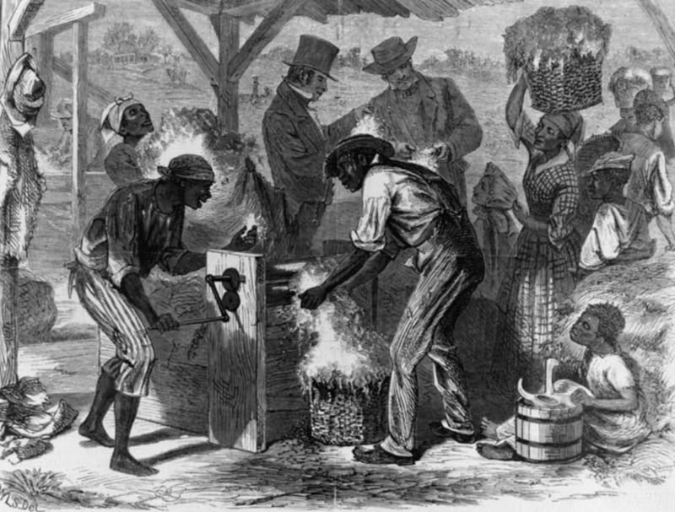
Eli Whitney (1765-1825)
Eli Whitney was an American inventor best known for inventing the cotton gin. This was one of the key inventions of the Industrial Revolution and shaped the economy of the American South. (right: first cotton gin)

Slide 8
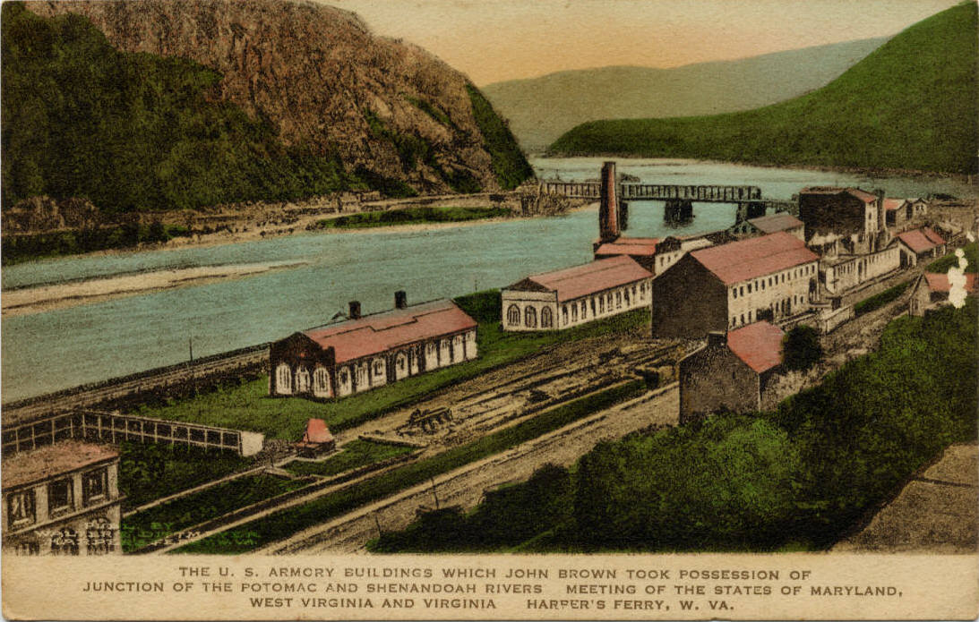
John H. Hall (1781–1841)
John H. Hall was an inventor and entrepreneur. He was the director of the Rifle Works at the Harpers Ferry Armory. Hall developed and improved his system of manufacture, and his system was soon deployed in the manufacture of newly invented mass consumption items, such as sewing machines, typewriters, and bicycles. (right: The Harpers Ferry Armory)

Slide 9
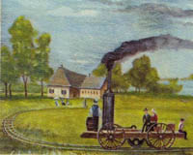
The Stevens Family and Transportation
The father John Stevens and his sons made numerous contributions of the building of steamboats, and his two sons, Robert Livingston Stevens and Edwin Augustus, made long distance railroading. Their contributions were mainly concerned with the essential problem of railroad tracks, the size and speed of trains. Without such gradual development of the technology, the long distance, many carriage freight trains would not have been feasible.

Slide 10
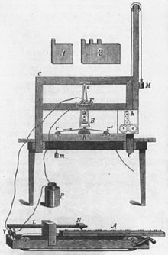
Samuel F. B. Morse (1791 –1872)
Morse contributed to the invention of a single-wire telegraph system based on European telegraphs. He was a co-developer of the Morse code, and helped to develop the commercial use of telegraphy. (right:
original Samuel Morse telegraph)

Slide 11
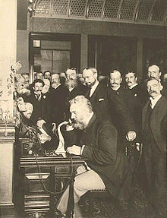
Alexander Graham Bell (1847 –1922)
Alexander Graham Bell was an eminent scientist, inventor, engineer and innovator who is credited with inventing the first practical telephone. (right: Bell at the opening of the long-distance line from New York to Chicago in 1892.)

Slide 12
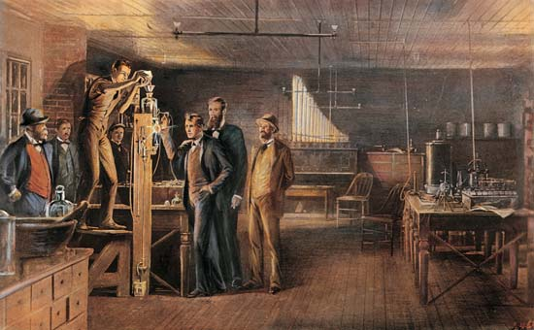
Thomas Alva Edison (1847 –1931)
Edison was a famous inventor. His workshops located in Menlo Park (right), NJ, brought forth the system of motion picture, the phonograph and a long-lasting, practical electric light bulb. He developed many devices that greatly influenced life around the world. He was one of the first inventors to apply the principles of mass production and large-scale teamwork to the process of invention, and he credited with the creation of the first industrial research laboratory.

Slide 13
II. The Early and Mid-Twentieth Century
Frederick Winslow Taylor: developing the science of management based on his time-motion studies;
Henry Ford: an American industrialist, and sponsor of the development of the assembly line technique of mass production
The growth of the broadcast radio business in America;
The developing household technologies: the refrigerator, home oil furnaces, washing machines, vacuum cleaners, electric dishwashers, etc.

Slide 14
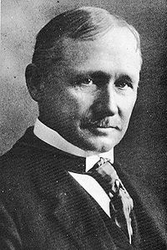
Frederick Winslow Taylor (1856 1915)
Frederick Winslow Taylor was a mechanical engineer who sought to improve industrial efficiency. He is regarded as the father of scientific management and one of the intellectual leaders of the Efficiency Movement. His theory known as Taylorism was highly influential in the Progressive Era.

Slide 15
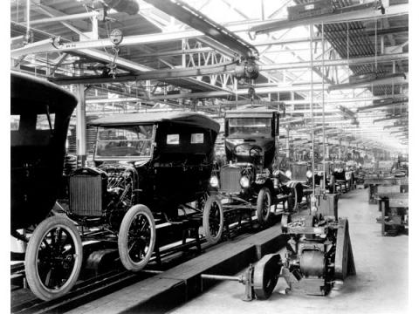
Henry Ford (1863-1947)
Henry Ford was the founder of the Ford Motor Company and sponsor of the development of the assembly line technique of mass production. He developed and manufactured the first automobile that many middle class Americans could afford. His Model T automobile (right) revolutionized transportation and American industry.

Slide 16
The Growth of the Broadcast Radio Business
At first, radio was used only for the transmission of messages from one point to another. Only amateurs experimented with the system of broadcasting widely to many potential listeners.
David Sarnoff, an employee of Marconi’s company, had plans for profitable radio broadcasting in 1916. So, in 1920 the first commercial broadcasting station, KDKA, began broadcasting from Pittsburgh, PA to a small group of listeners.
After World War I, the growing broadcast radio business served many functions. It provided entertainment, news, information, and advertisements to feed a growing consumerism in America.

Slide 17
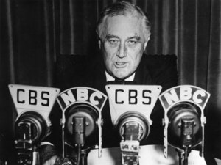
The Growth of the Broadcast Radio Business
During the economic depression of the 1930’s, President Franklin D. Roosevelt held Fireside Chats in an effort to restore confidence in the economy and in the government.

Slide 18
The Developing Household Technologies
Household technologies include inventions such as the refrigerator, home oil furnaces instead of coal burning ones, automatic laundry machines, vacuum cleaners, electric dishwashers.
These inventions as well as the newer ones such as the microwave oven, the electric blender, the food processor, and so on, should have freed housewives from tedious work and made much more time available to them.
Careful study shows however that women today spend more time on household chores than in the past.

Slide 19
III. The Late Twentieth Century and Today
Television and the Age of Visual Information;
Militarily useful inventions;
US Space Race with the U.S.S.R;
Nuclear development;
Computers;
The Internet;
Renewable energy technologies

Slide 20
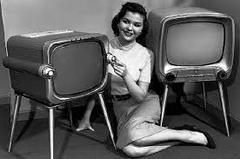
Television and the Age of Visual Information
Television developed fast After WWII. The pioneers of television believed that the primary use of this new device would be educational. But experience showed that sports activities, quiz shows, and theatrical shows were more popular. At the end of the century, it was apparent that American schoolchildren were spending less time studying, and less time playing sports, and more time sitting passively in front of a TV set. Adults too were addicted to TV. With the wide spread of TV, the Age of Visual Information had arrived.

Slide 21
Militarily Useful Inventions
As World War II approached, the U.S. military began to sponsor research into militarily useful inventions leading to significant technical developments useful for military purposes. Yet in peacetime many of these military developments found a use in the wider society: radar for traffic control, microwave cooking (using the radar microwave generator for heating), nuclear energy, peaceful uses of computers.

Slide 22
US Space Race with the U.S.S.R
On 4 October 1957, the Soviet Union successfully launched Sputnik 1 into space, the first artificial satellite to orbit the Earth, making the USSR the first space power. Four months after the launch of Sputnik 1, the United States successfully launched its first satellite, Explorer 1, becoming the second space power and entering the Space Race with the USSR. The Space Race became an important part of the cultural, technological, and ideological rivalry between the United States and the Soviet Union during the Cold War.

Slide 23
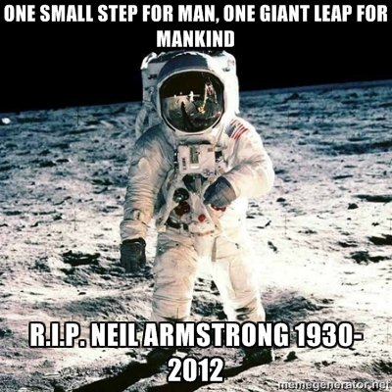
US Space Race with the U.S.S.R
In 1961, the then President John F. Kennedy announced that America would land a man on the moon by the end of the decade. His goal was fulfilled by the Apollo 11 mission when the mission commander Neil Armstrong became the first human to set foot on the lunar surface on 20 July 1969.

Slide 24
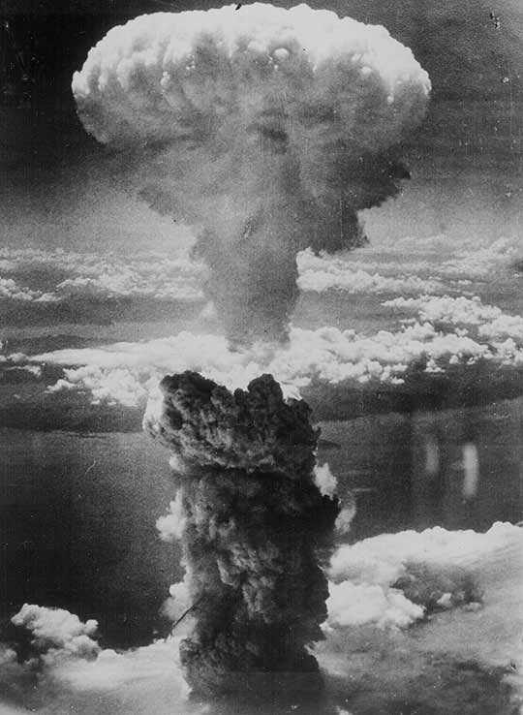
Nuclear Development
By August 1945, the Allied Manhattan Project had successfully detonated an atomic device and subsequently produced atomic weapons based on two alternate designs. In August 1945, during the final stage of the Second World War, the United States dropped atomic bombs on the Japanese cities of Hiroshima and Nagasaki.

Slide 25
Nuclear Development
After WWII, nuclear reactors were developed to generate electricity. Nuclear developments in the USA suffered a major setback after the 1979 Three Mile Island accident. Nevertheless, by 1990 over 100 commercial power reactors had been commissioned. Now there are more than 110 nuclear power reactors in 31 states, generating almost 20% of total electricity produced in this country in 2008. The USA is the world’s largest producer of nuclear power, accounting for more than 30% of worldwide nuclear generation of electricity.

Slide 26
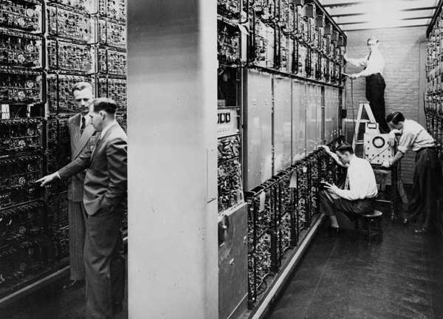
Computer Science
Electronic computers originally were developed to assist artillery to predict the path of fired shells, and also to break enemy cryptographic messages. These machines were enormous in size, using miles of wires and thousands of vacuum tubes. They consumed great quantities of electricity. Peacetime applications seemed limited. (right: early computers)

Slide 27
Computer Science
It was up to two young visionary tinkerers, in the American tradition of amateur inventors, to devise a smaller, personal computer (PC). Young Steve Jobs, working in his garage with his friend Steve Wozniak, was finally able to package a small desktop computer that could process symbols. Another young man, Bill Gates devised a set of instructions, a Disc Operating System, or DOS.

Slide 28
Computer Science
Steve Jobs (1955-2011) was an American entrepreneur, marketer, and inventor who was the co-founder, chairman, and CEO of Apple Inc. Through Apple, he is widely recognized as a charismatic and design-driven pioneer of the personal computer revolution and for his influential career in the computer and consumer electronics fields, transforming “one industry after another, from computers and smart phones to music and movies.” Jobs oversaw the development of the iMac, iTunes, iPod, iPhone, and iPad. The success of these products propelled Apple to become the world’s most valuable publicly traded company in 2011.

Slide 29


Slide 30
Computer Science
Bill Gates (1955- ) is an American business magnate, philanthropist, inventor, computer programmer, and inventor. Gates is the former chief executive and chairman of Microsoft, the world’s largest personal-computer software company, which he co-founded with Paul Allen. He is consistently ranked in the Forbes list of the world’s wealthiest people and was the wealthiest overall from 1995 to 2009—excluding 2008, According to the Bloomberg Billionaires List, Gates became the world's richest person again in May 2013. In the later stages of his career, Gates has pursued a number of philanthropic endeavors, donating large amounts of money to various charitable organizations and scientific research programs through the Bill & Melinda Gates Foundation, established in 2000.

Slide 31
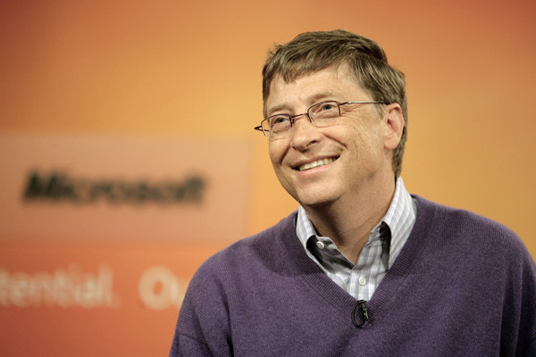
Bill Gates

Slide 32
The Internet
The potentials of computerized technologies can never be exaggerated. Perhaps the most powerful one is the Internet. It emerged in the Unites States in 1968 during the period of the Cold War, the original idea being to connect computers housed at military strategic locations throughout the US for the purpose of saving the information in the event of a nuclear attack. Later four universities in the American West were connected to the system. Over the years after 1969 more and more computers were joined to the system and increasing information was added to its database. Many educational, private and commercial networks joined in. Useful tools were invented such as the e-mail and www (the World Wide Web).

Slide 33

Renewable Energy Technologies
Today, climate change concerns, coupled with high oil prices, are propelling the fast growth of renewable energy technologies. Renewable energy is generated from natural resources such as sunlight, wind, rain, tides, and geothermal heat. It has low or zero carbon emissions. America is engaged in developing such green energy technologies. Clean renewable energy technologies have an increasingly large market and a bright future.

Slide 34
Questions for Discussion
What role does technology play in our lives? Does it only provide new conveniences or does it sometimes change our life style? Give examples from the text to illustrate your ideas.
Who are some of the greatest inventors in the US?
What do you think is the greatest invention so far? Why
What do you know about Bill Gates and Steve Jobs?
Discuss what role the Internet plays in your life.

Slide 35
The End
高等教育出版社
2015

